Slide 1





AILO:
DISEASE PREDICTION
23R11A05B1 SANJAY
23R11A05B3 KEERTHANA
23R11A05C1 GABRIEL

Slide 2

Introduction
Healthcare is one of the most crucial sectors needing digital transformation.
Early disease prediction helps in quick diagnosis and treatment.
This project aims to develop a web application that predicts diseases based on input symptoms using AI/ML techniques.

Slide 3

Objectives
Accept user-reported symptoms via a web interface.
Predict the most probable disease.
Display relevant disease details and suggested precautions.
Ensure user-friendly and responsive interface.

Slide 4

Tech Stack
Frontend: HTML, CSS, JavaScript
Backend: Python (Flask or Django)
Machine Learning: Scikit-learn / Pandas
Tools: Jupyter Notebook, VS Code

Slide 5

MACHINE LEARNING ALGORITHMS
Algorithms Used:
Decision Tree
Random Forest
Naive Bayes (optional)

Slide 6
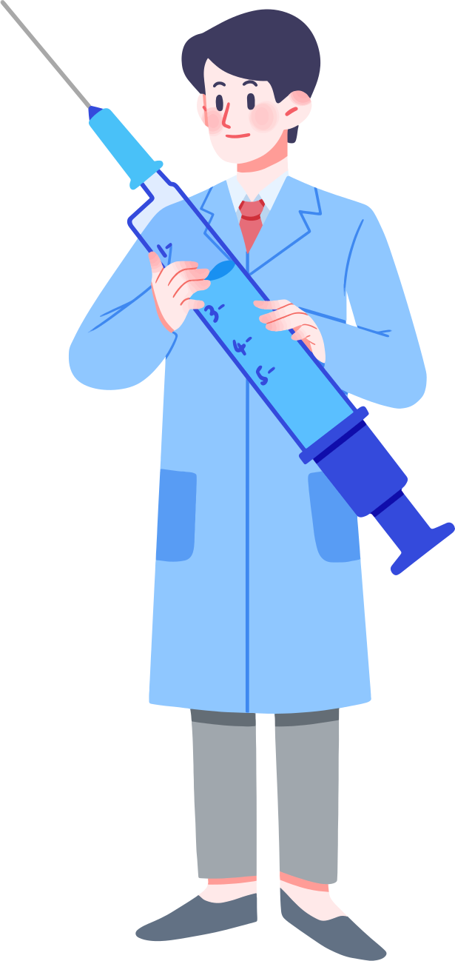
ALGORITHM EXPLAINATION
DECISION TREE : A decision tree splits data into branches based on feature values, creating a tree-like structure.
RANDOM FOREST : Random forest is an ensemble method that combines multiple decision trees.
NAIVE BAYES : Based on Bayes' theorem and assumes all features are independent of each other .

Slide 7
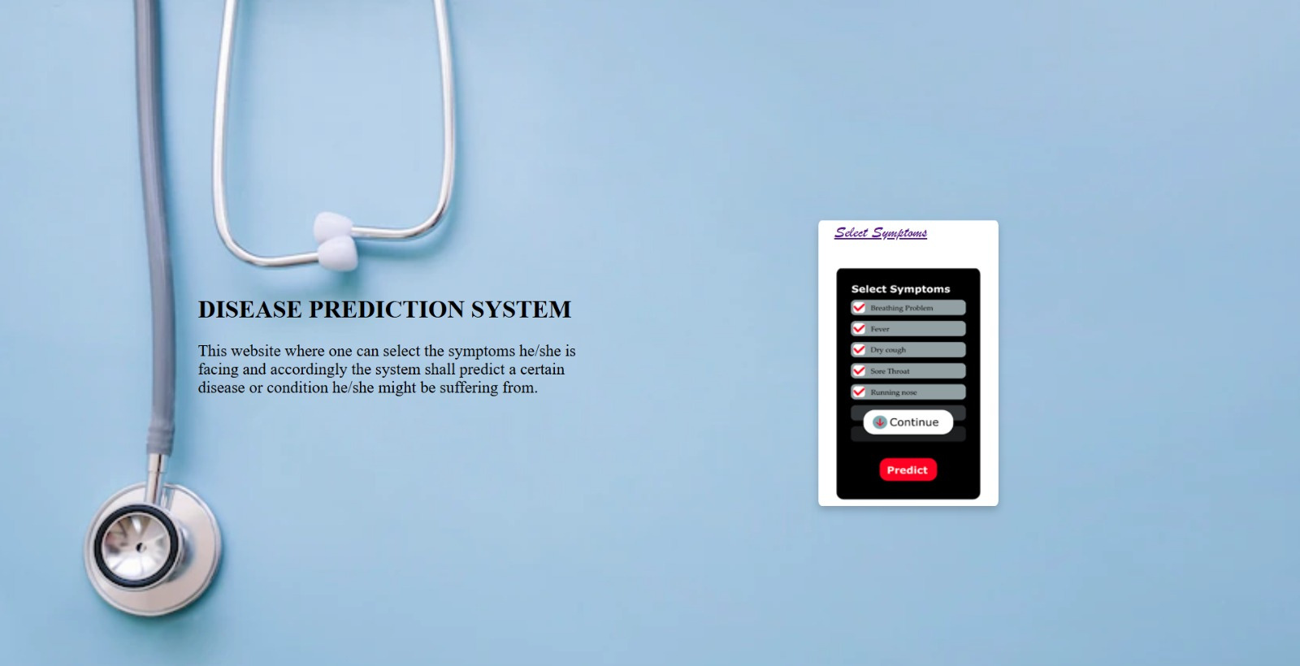

Slide 8
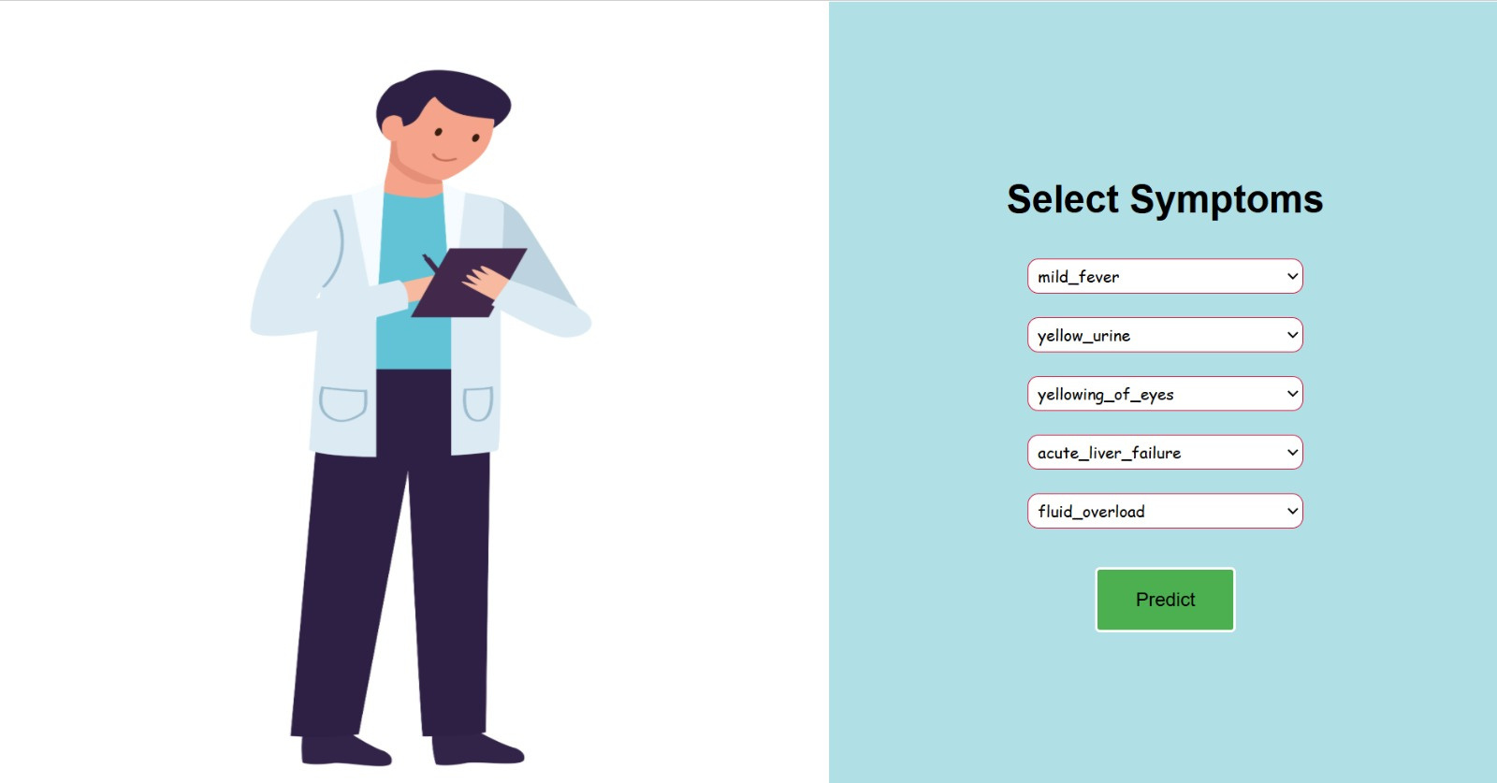

Slide 9
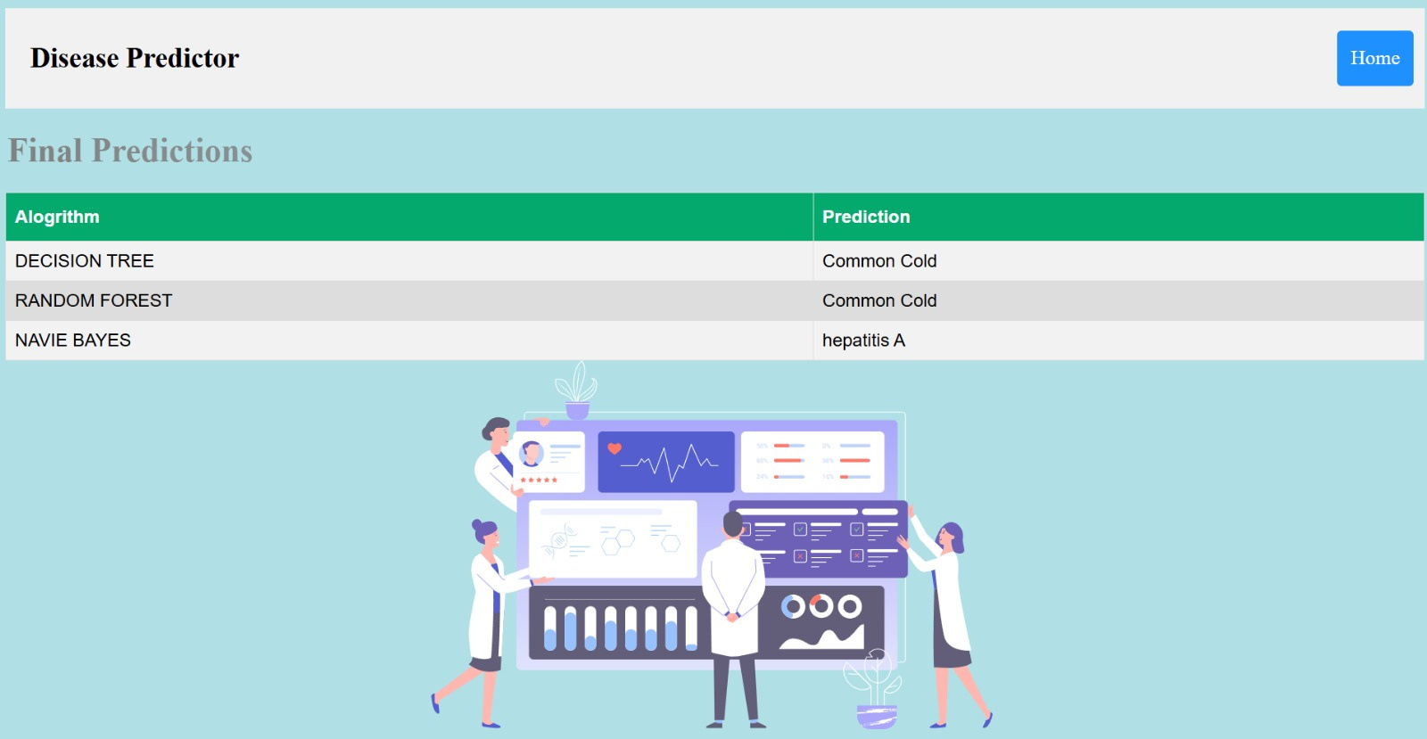

Slide 10

THANK
YOU

